Slide 1
ED-BP: Belief Propagation via Edge Deletion
UCLA Automated Reasoning Group
Arthur Choi, Adnan Darwiche,
Glen Lenker, Knot Pipatsrisawat
Last updated 07/15/2010: See the speaker notes on each slide for commentary (PowerPoint only).
Notes:
Originally presented at UAI-10 for the inference challenge. The official homepage for the UAI-10 Inference Challenge is here:
http://www.cs.huji.ac.il/project/UAI10/index.php

Slide 2
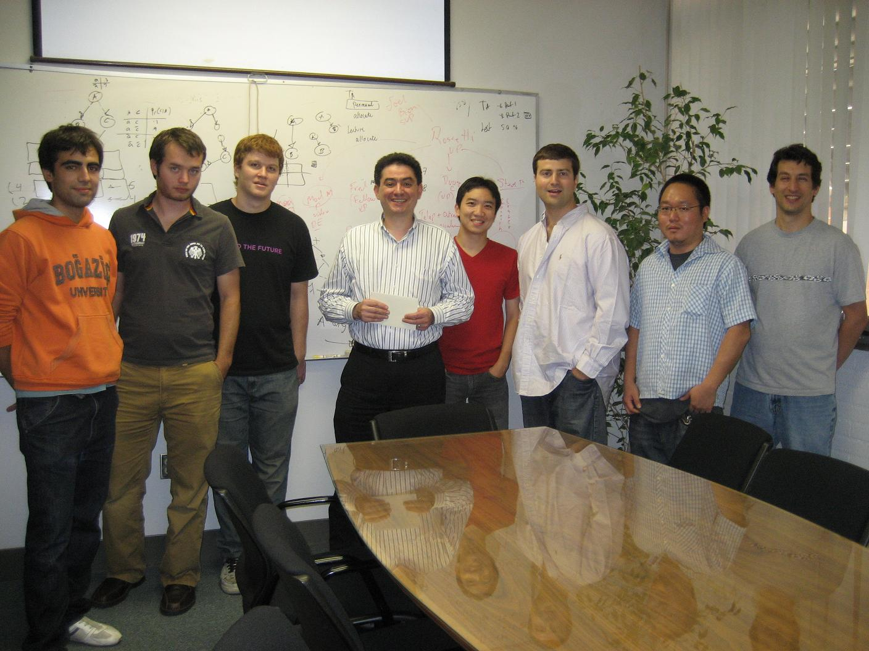
Glen
Adnan
Knot
Arthur
Notes:
The solver was developed by Arthur Choi, supervised by Adnan Darwiche. Knot Pipatsrisawat provided support with RSat, and Glen Lenker provided general support. UCLA’s Automated Reasoning Group can be found here:
http://reasoning.cs.ucla.edu/

Slide 3
ED-BP: Idea
loopy BP
Delete Edges
Compensate
Notes:
ED-BP is an approach to approximate inference that is based on performing exact inference in a model simplified by deleting edges. Not only do we delete edges, we compensate for them as well. It so happens that loopy belief propagation can be viewed as a specific way for compensating for deleted edges, in the case where the network has been simplified to a tree (even a fully-disconnected one).

Slide 4
Characterizing Belief Propagation
ED-BP characterization:
in a tree:
MAR: BP marginals
PR: Bethe
MPE: BP max-marginals
X_{i}
Pr(X_{i} = x) = Pr(X_{j} = x)
= θ(X_{i} = x)θ(X_{j} = x)/z_{ij}
θ(X_{i})
θ(X_{j})
X_{j}
Notes:
In AAAI’06, Choi & Darwiche identified a specific way to compensate for deleted edges.
We have deleted an edge Xi and Xj here, and have further introduced auxiliary factors into the model (one on Xi and one on Xj). We proposed that these parameters should be chosen so that the simplified network satisfies the conditions given here. To find these parameters, we proposed an algorithm that performs exact inference in the simplified model, iteratively updating the parameters until the distribution (hopefully) converges to the desired one.
In the case the simplified model is a tree (even a fully-disconnected one), we show that iteratively updating these parameters is analogous to message-passing in BP. Moreover, exact inference in the simplified network corresponds to BP approximations:
= the marginals of the simplified network are BP marginal approximations (AAAI’06)
= the partition function of the simplified network is the Bethe approximation (UAI’08)
= the MPE solution of a (similar) simplified network is the MPE solution given by max-product BP (NIPS’09)

Slide 5
Edge Deletion
exact
delete edges
?
Notes:
A tree-structured approximation is extreme: we can delete fewer edges and expect a better approximation! But how do we decide which edges to delete? This would seem to require exact inference, which we assume we can’t do in the first place.

Slide 6
Edge Recovery
loopy BP
…
recover edges
recover edges
exact
…
recover edges
recover edges
Notes:
Instead, we start with a tree-structured approximation and opt to recover edges instead. We reason in the simpler network about what edges are problematic, and recover them, handling them exactly. We do this repeatedly, 10% of the edges at a time, each time re-evaluating which edges to recover based on the improved approximation. We do this until we recover all edges (and get exact inference), or until we run out of space or time.

Slide 7
Edge Recovery: Old Idea
loopy BP
…
recover edges
recover edges
[CD06]: target quality: use mutual information
…
recover edges
recover edges
Notes:
In AAAI’06, we proposed an edge recovery heuristic that targeted the quality of the approximation. We proposed a mutual information heuristic, which we found to be effective in finding quality approximations, yet it can be too slow to compute mutual information for each edge, especially when many edges are deleted. The problem is we may spend too much time ranking edges, rather than actually recovering them and improving our approximation.

Slide 8
Edge Recovery: New Idea
loopy BP
…
recover edges
recover edges
Challenge UAI-10: encourage convergence, residual recovery
…
recover edges
recover edges
Notes:
For the purposes of the UAI-10 challenge, we developed a new edge recovery heuristic, which we call residual recovery (which was inspired by residual BP), where we focus on recovering edges so as to encourage fast convergence. The advantages of residual recovery is that it is efficient (allowing us to recover more edges faster), improves the rate of convergence (further improving overall time efficiency), and encourages convergence (which would otherwise leave us without a meaningful approximation).

Slide 9
ED-BP: Residual Recovery
Recover edges based on how close they are to convergence
ED-BP characterization:
Ongoing: try residuals as in residual BP
X_{i}
θ(X_{i})
Pr(X_{i} = x) = Pr(X_{j} = x)
= θ(X_{i})θ(X_{j})/z_{ij}
θ(X_{j})
X_{j}
Notes:
We examine each edge, and use our convergence criterion (given here), to determine how close an edge is to converging. If we find during the iterative process for finding edge parameters, that an edge is having difficulty converging, we recover that edge and handle it exactly, and continue.

Slide 10
Exact Solvers
Exact inference in a simplified network: ED-BP can use any black box inference engine
currently using vanilla Hugin and Shenoy-Shafer jointree algorithms
not currently using Ace, or other advanced inference engines …
Notes:
Since ED-BP formulates approximate inference as exact inference in a simplified network, we can in principle use any exact inference algorithm as a black-box reasoning engine within ED-BP. For the purposes of the UAI-10 challenge, we used standard jointree algorithms for exact inference: a Hugin-style algorithm (which is more time efficient) and a Shenoy-Shafer style algorithm (which is more memory efficient). UCLA’s automated reasoning group however has developed a number of more advanced inference algorithms for reasoning in Bayesian networks, which could also be used with ED-BP.

Slide 11
Overall Results
PR Task: 20 Seconds
MAR Task: 20 Seconds
Solver | Score
edbr | 1.7146
vgogate | 2.1620
libDai | 2.2775
Solver | Score
edbq | 0.2390
libDai2 | 0.3064
vgogate | 0.4409
Notes:
We submitted three variants of ED-BP, named edbp, edbq and edbr. We provide a ranking of the solvers here, showing only the leading solver for each class of solvers.
ED-BP solvers won the PR and MAR categories at the 20s time limit. Residual recovery was the key technique that gave us our initial leads in these 2 categories. Further improvements allowed us to maintain that lead until the end of the challenge.

Slide 12
Overall Results
PR Task: 20 Minutes
MAR Task: 20 Minutes
Solver | Score
vgogate | 1.2610
edbp | 1.3063
libDai | 2.0707
Solver | Score
ijgp | 0.1722
edbq | 0.1742
libDai3 | 0.2810
Notes:
ED-BP solvers had also led the PR and MAR categories at 20 minutes and 1 hour, but ultimately lost the leads to Vibhav. The MAR category at 20 minutes was particularly close. By our count, the lead changed at least 4 times in the last moments of the challenge.

Slide 13
Overall Results
PR Task: 1 Hour
MAR Task: 1 Hour
Solver | Score
vgogate | 1.2609
edbr | 1.2699
libDai | 2.0707
Solver | Score
ijgp | 0.1703
edbr | 0.1753
libDai3 | 0.2639
Notes:
Again, the scores here are relatively close (as compared to the differences at 20s).

Slide 14
Overall Results
PR Task: 1 Hour
MAR Task: 1 Hour
Solver | Score
vgogate | 1.2609
edbr | 1.2699
libDai | 2.0707
Solver | Score
ijgp | 0.1703
edbr | 0.1753
libDai3 | 0.2639
Congratulations Vibhav
Notes:
But not close enough! Congratulations to Vibhav!
(Thanks also to the organizers Gal, Amir and Uri).

Slide 15
More Slides on the ED-BP Solver

Slide 16
ED-BP: The Solver
Based on UAI'08 solver, new MPE version
Numerous improvements
pre-processing
initial spanning tree
internal inference engine for exact reasoning
edge recovery
led to biggest impact in performance

Slide 17
ED-BP: The Solver
Pre-processing
lightweight
RSat: infer fixed values from network zero’s
Initial spanning tree
random spanning tree
max spanning tree (mutual information)
Black box engine for exact inference
jointree algorithms: shenoy-shafer versus hugin
in the future: compilation to ACs (Ace)

Slide 18
References
Arthur Choi, Hei Chan, and Adnan Darwiche. On Bayesian Network Approximation by Edge Deletion. In Proceedings of the 21st Conference on Uncertainty in Artificial Intelligence (UAI), 2005.
Arthur Choi and Adnan Darwiche. An Edge Deletion Semantics for Belief Propagation and its Practical Impact on Approximation Quality. In Proceedings of the 21st National Conference on Artificial Intelligence (AAAI), 2006.
Arthur Choi and Adnan Darwiche. A Variational Approach for Approximating Bayesian Networks by Edge Deletion. In Proceedings of the 22nd Conference on Uncertainty in Artificial Intelligence (UAI), 2006.
Arthur Choi, Mark Chavira, and Adnan Darwiche. Node Splitting: A Scheme for Generating Upper Bounds in Bayesian Networks. In Proceedings of the 23rd Conference on Uncertainty in Artificial Intelligence (UAI), 2007.
Arthur Choi and Adnan Darwiche. Approximating the Partition Function by Deleting and then Correcting for Model Edges. In Proceedings of the 24th Conference on Uncertainty in Artificial Intelligence (UAI), 2008.
Arthur Choi and Adnan Darwiche. Focusing Generalizations of Belief Propagation on Targeted Queries. In Proceedings of the 23rd AAAI Conference on Artificial Intelligence (AAAI), 2008.
Arthur Choi and Adnan Darwiche. Many-Pairs Mutual Information for Adding Structure to Belief Propagation Approximations. In Proceedings of the 23rd AAAI Conference on Artificial Intelligence (AAAI), 2008.
Arthur Choi and Adnan Darwiche. Approximating MAP by Compensating for Structural Relaxations. In Proceedings of the Twenty-Third Annual Conference on Neural Information Processing Systems (NIPS), 2009.
Arthur Choi, Trevor Standley, and Adnan Darwiche. Approximating Weighted Max-SAT Problems by Compensating for Relaxations. In Proceedings of the 15th International Conference on Principles and Practice of Constraint Programming (CP), 2009.

